Slide 1
Health issues and societal solutions
Presented By-
1BY20IS059 Harsh Singh
1BY20IS065 Jitendriyadeep
1BY20IS072 Lakshya Agarwal
1BY20IS073 M Tharun Kumar
1BY20IS075 Lokesh E
1BY20IS078 Manish Kumar Yadav

Slide 2
Health Issues and Societal Solutions Related to Information Technology
This presentation discusses the potential health issues caused by heavy computer use and the societal solutions that information technology can provide in areas like medical diagnosis, crime control, and environmental quality control.

Slide 3
Health Issues Related to Information Technology
Heavy computer use is reportedly causing health problems like job stress, damaged arm and neck muscles, eyestrain, radiation exposure, and even death by computer caused accidents.
Computer monitoring is blamed as a major cause of computer-related job stress.
Cumulative trauma disorders (CTDs) can result from fast-paced, repetitive keystroke jobs on PC workstations or visual display terminals (VDTs).
Carpal tunnel syndrome may result from strained muscles, back pain, and nerve damage.

Slide 4
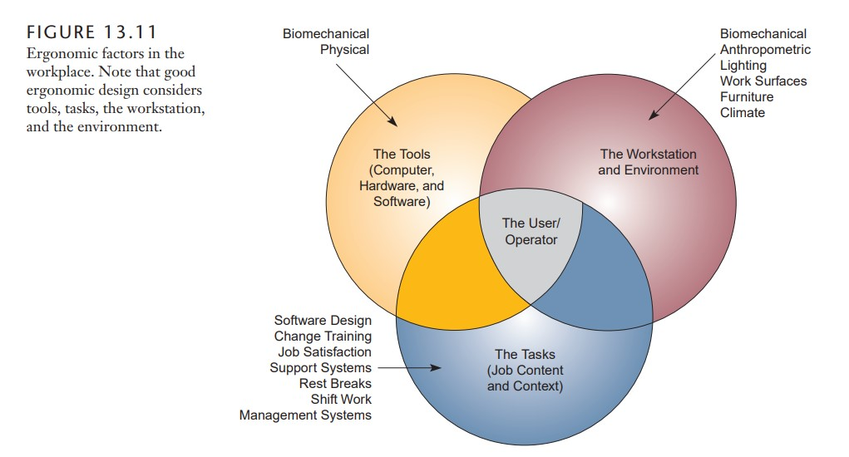

Ergonomics
Solutions to some of these health problems are based on the science of ergonomics , sometimes called human factors engineering.
The goal of ergonomics is to design healthy work environments that are safe, comfortable, and pleasant for people to work in, thus increasing employee morale and productivity

Slide 5

Societal Solutions through Information Technology
Information technologies can have many benefits for society, including medical diagnosis, computer-assisted instruction, law enforcement, environmental quality control, and program planning.
Computers can assist in diagnosing illnesses, prescribing treatment, and monitoring the progress of hospital patients.
Law enforcement applications like computerized alarm systems and monitoring can aid in crime control.
Computers can monitor pollution levels and issue early warnings when dangerous levels are reached.

Slide 6

Governmental Program Planning with Information Technology
Computers are used in program planning for various government agencies, including urban planning, population density and land use studies, highway planning, and urban transit studies.
Computers are being used in job placement systems to help match unemployed persons with available jobs.

Slide 7
Thank you for your time and attention 🙂

